Slide 2
WebSmart by JR3
This easy to use software is:
Secure
Flexible
Multi-year online access at your fingertips
Web browser based and can operate on one laptop or multiple servers – NO software installation required
Scalable to fit the needs and requirements of any sized Texas school
An integrated package providing seamless access to Finance, Student Services, and PEIMS
Compatible with multiple data bases from MYSQL to Oracle

Slide 3
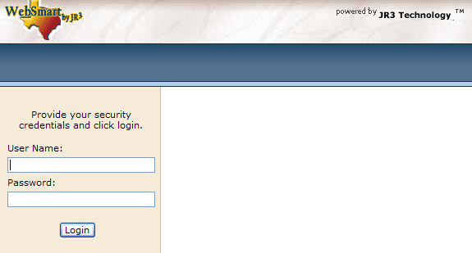
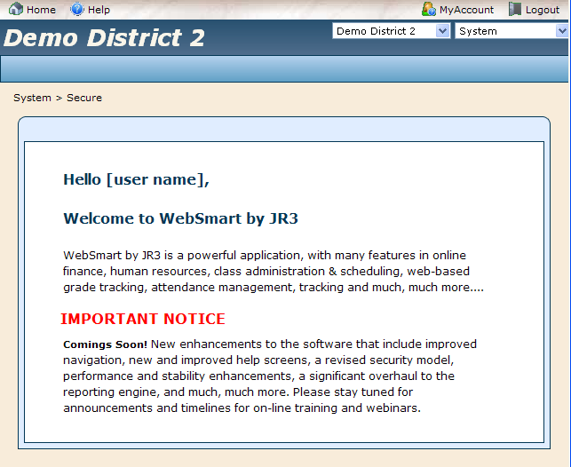
User Friendly
WebSmart’s web based system is safe and secure, while remaining very user friendly
Go to the WebSmart URL for the District
Login using a District issued User Name and Password
Then you are able to navigate based on the access rights to the system that you have been given

Slide 4
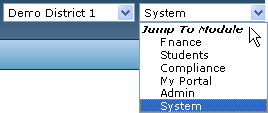
The Layout
The design of the program allows for easy navigation from screen to screen.
The drop menus in the upper right allow easy navigation between districts and modules
The navigation buttons in the upper corners provide you with quick access to helpful tools
Home: returns you to the opening screen
Help: provides you with online resources, including step-by-step “how-to” instructions, links to state and federal websites, and training videos
My Account: allows you to change your password and upload a signature for requisition approvers
Logout: to be used when exiting the program
Since the system is web-based it is important to know you are securely logged off. However, if you are inactive longer than a set time frame the system will log you out to prevent non-authorized users access through your login.

Slide 5
WebSmart Icons
Update
Add
Edit
Cancel
Delete
Primary
Calendar
Return to Previous Menu
Run Report / Print
View
View Ledger
Here is a collection of icons used throughout the program
This consistency allows users trained in one aspect to be able to work in additional areas without requiring excessive additional training.

Slide 6
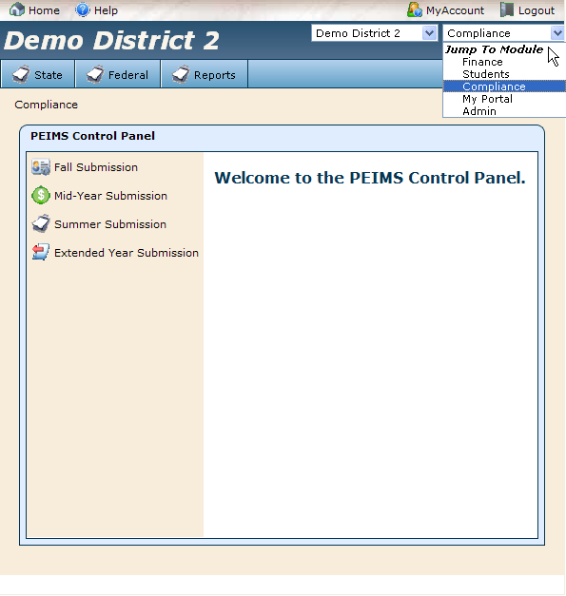
Integrated Business & Student Services
Automatic Student Services and Business Applications integration that meet PEIMS requirements with no duplicated data
PEIMS submissions do not require merging of data as you will see

Slide 7
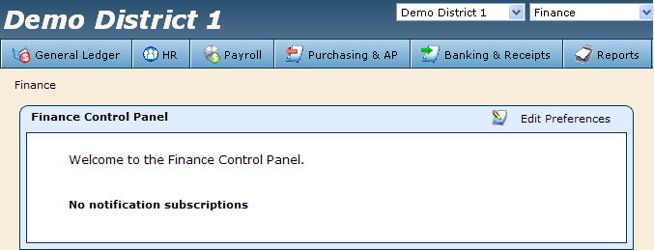
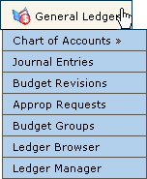
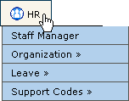
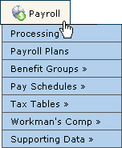
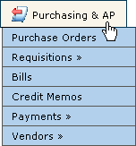
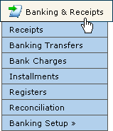
Finance
Human Resources
Payroll
Accounts Receivable
Accounts Payable
Purchasing/Requisition
Budget Management

Slide 8
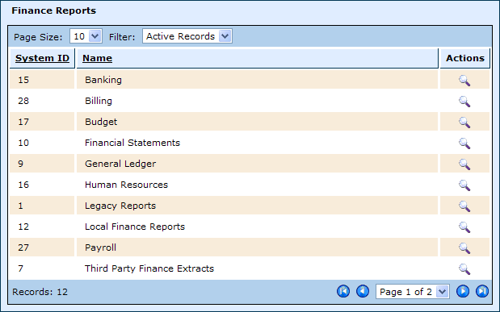
Finance Reports
WebSmart provides numerous reports that are customizable to meet your Finance needs
Reports are grouped into categories for ease in finding reports and delegating security

Slide 9
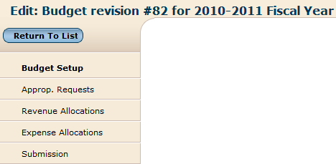
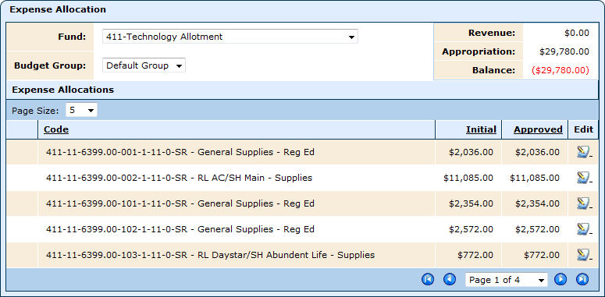
Budget – Revenue & Expenses
Easy to manage Budget screens that allow users to manage initial Budgets and all subsequent Revisions.
In addition, authorized users can electronically request Appropriation Request for any accounts to which the User has access.

Slide 10
Budget - Submission
This Submission is based off the Revenue and Allocations from the previous screen

Slide 11
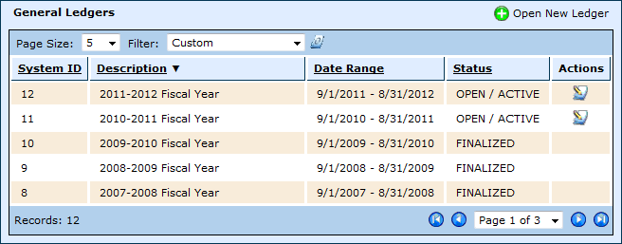
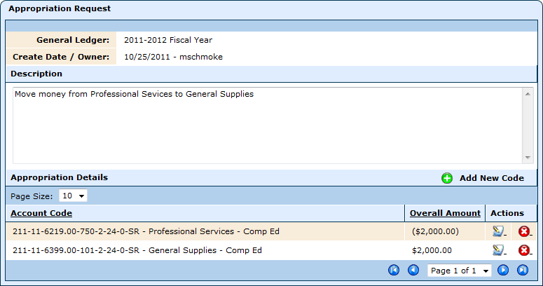
Ledger
WebSmart can maintain multiple Ledgers in 3 different states.
An Open Ledger allows all types of transactions with the ability to maintain Budgets, Payroll, Acct. Payables, and Banking transactions
A Closed Ledger is ready for Audit with Journal Entries as the only transaction able to be posted
A Finalized Ledger is fully reportable but cannot have any transactions posted to it

Slide 12
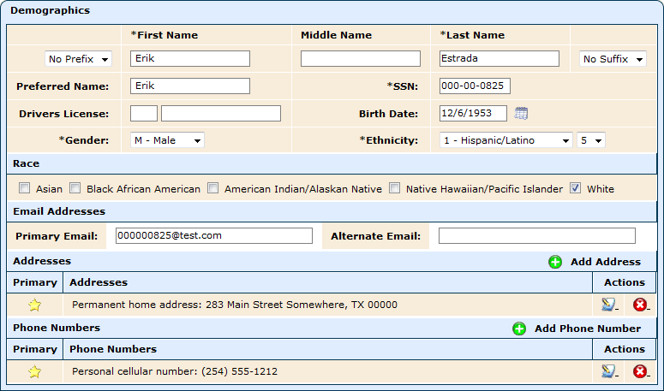
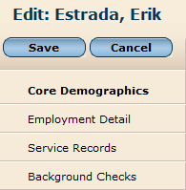
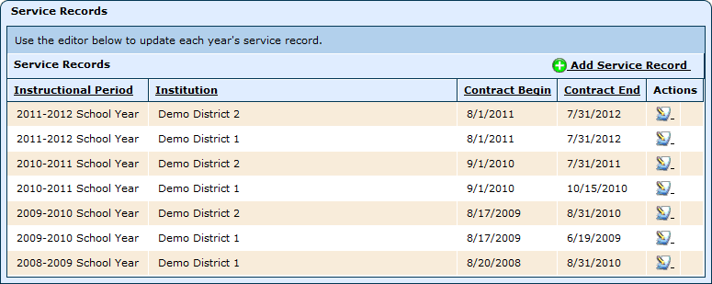
HR - Example
1
1
2
3
2
3
This is just an example, what you see will depend on the person attached to the record.

Slide 13
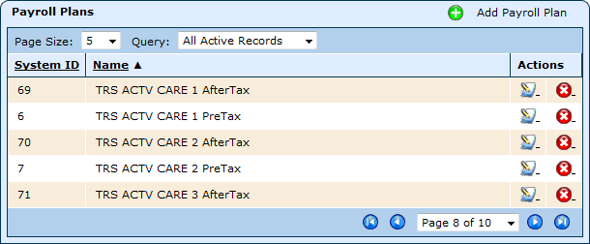
Payroll
You can manage:
Benefits
Pay Schedules
Payroll Plans

Slide 14
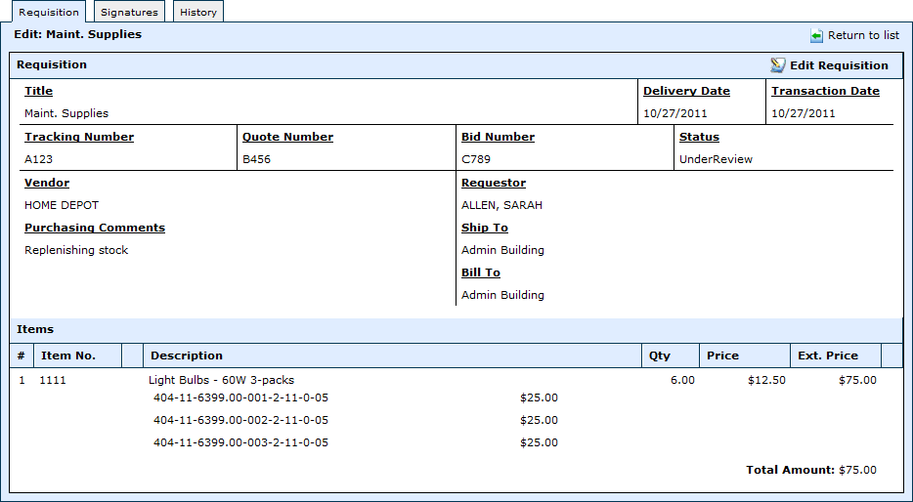
Purchasing & AP
Requisitions can be requested, approved, and converted to Purchase Orders, all online.
Line items can be split coded.
Approval permissions are used to “push” requisitions through a workflow and may be approved at one or many levels. All visible on the Signatures screen.
Account codes and vendors can be set to different levels for different user groups.

Slide 15
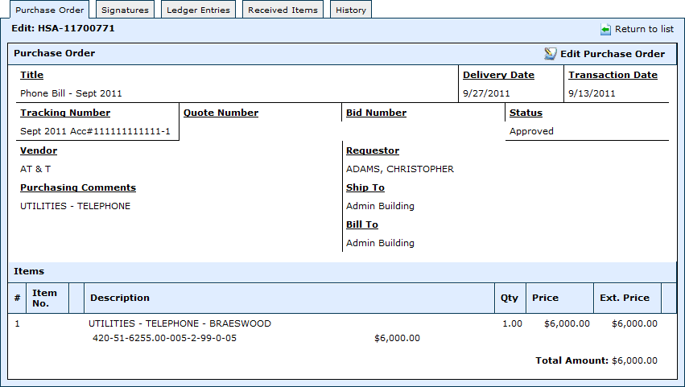
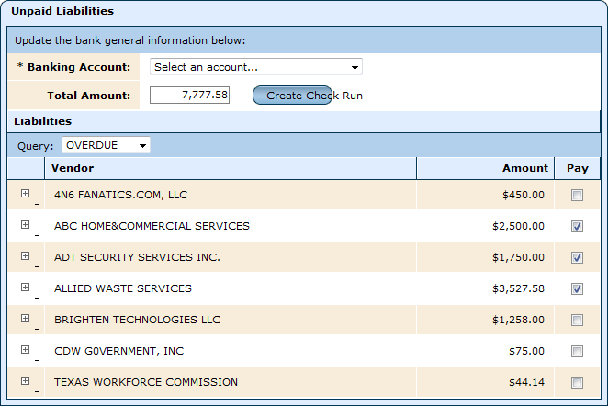
Purchasing & AP
Manage:
POs - including split coded line items
Bills - view the ledger and history directly from within the bill
Credit Memos
Payments - both electronic and paper checks
Vendors

Slide 16
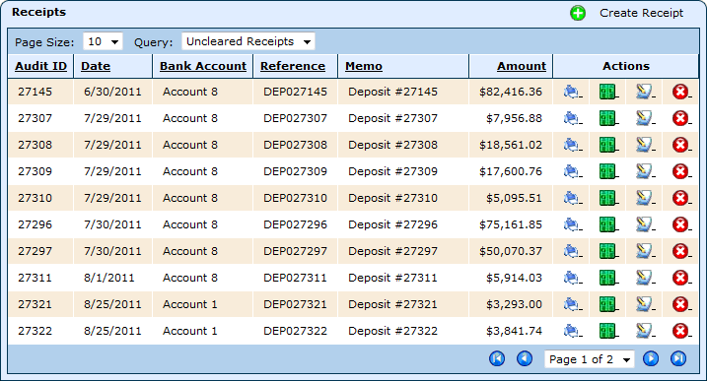
Banking & Receipts
Manage multiple accounts in one location
Print
View Ledger

Slide 17
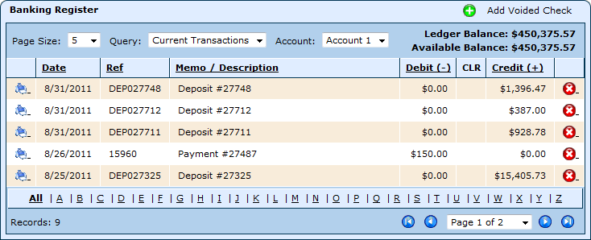
Banking & Receipts
Manage all your banking transactions
Easily void and reissue checks
View a visual running balance of cash on hand

Slide 18
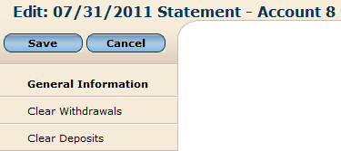
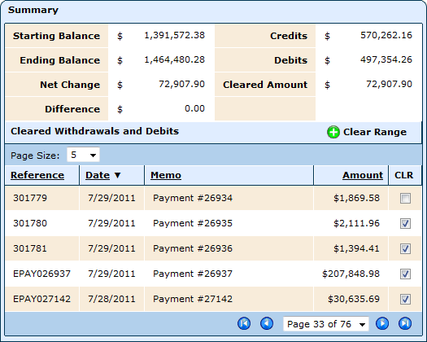
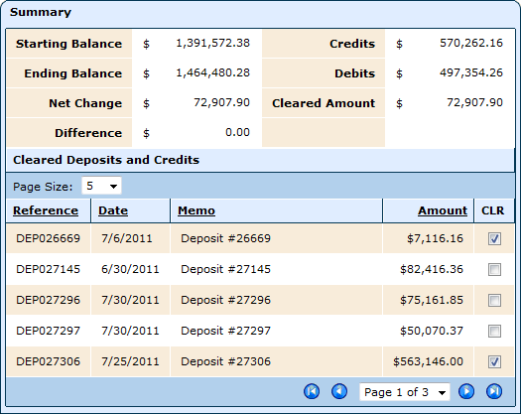
Banking & Receipts
Easy Reconciliation, simply check the boxes and click Save

Slide 19
Feel free to call and speak with one of our
WebSmart Finance professionals and let them
answer all of your questions
Toll Free (866) 759-1902
Or email us for more information
info@jr3online.com

Slide 20
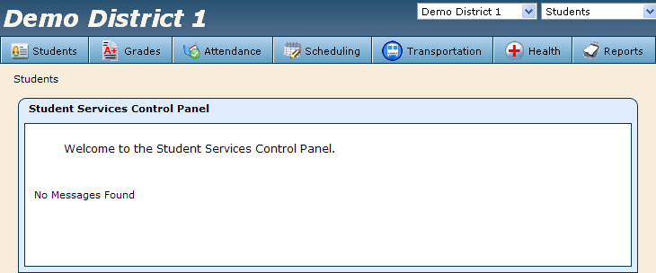
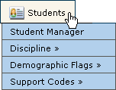
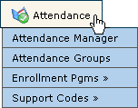
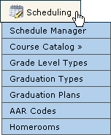
Students
Teacher Grade Book
Student Demographics
Student Attendance
Grade Reporting
Student Permanent Record Transcripts
Individual Student Discipline Reports
Student Health Records
Special Education
Scheduling
PEIMS
Parent Portal

Slide 21
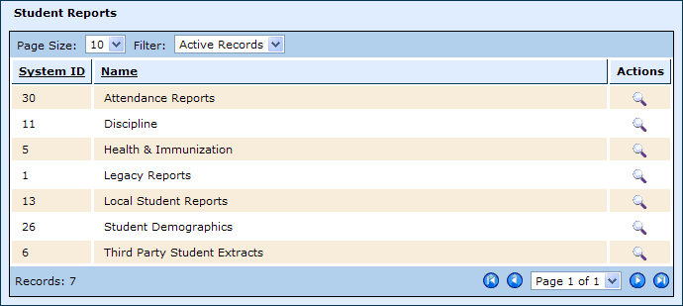
Student Reports
WebSmart provides numerous reports that are customizable to meet your Student Services needs
Reports are grouped into categories for ease in finding reports and delegating security

Slide 22
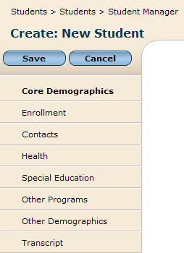
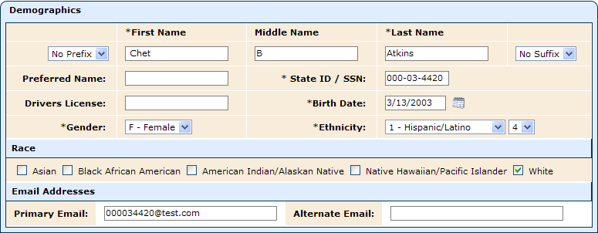
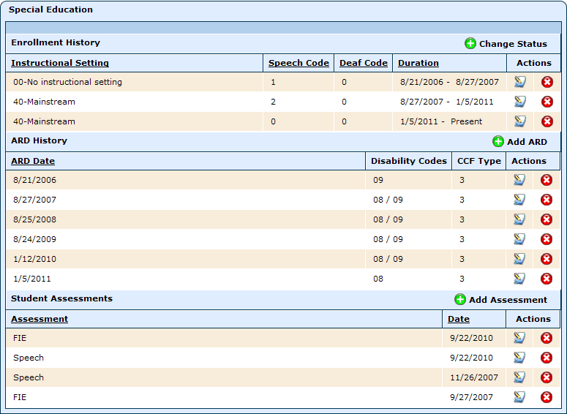
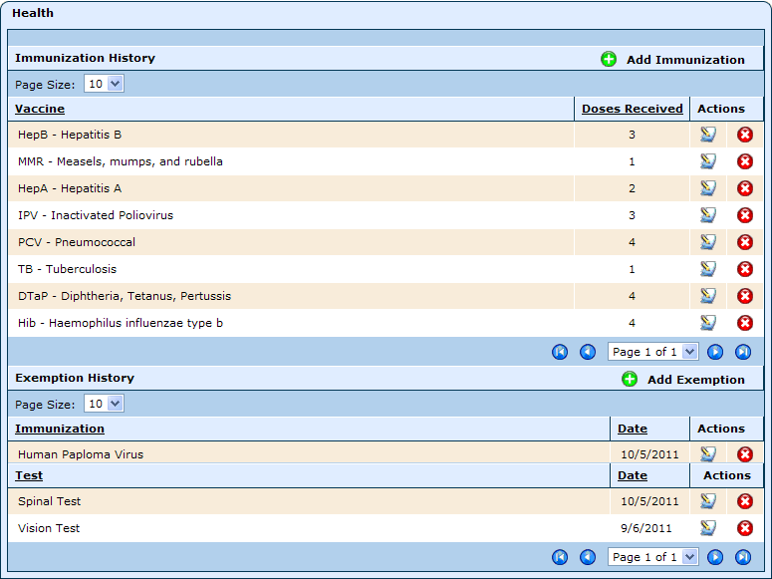
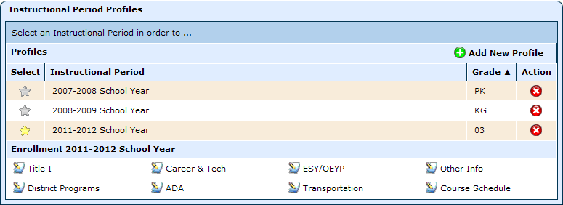
Student - Example
1
1
2
3
4
4
3
2
This is just an example, what you see will depend on the student attached to the record.

Slide 23
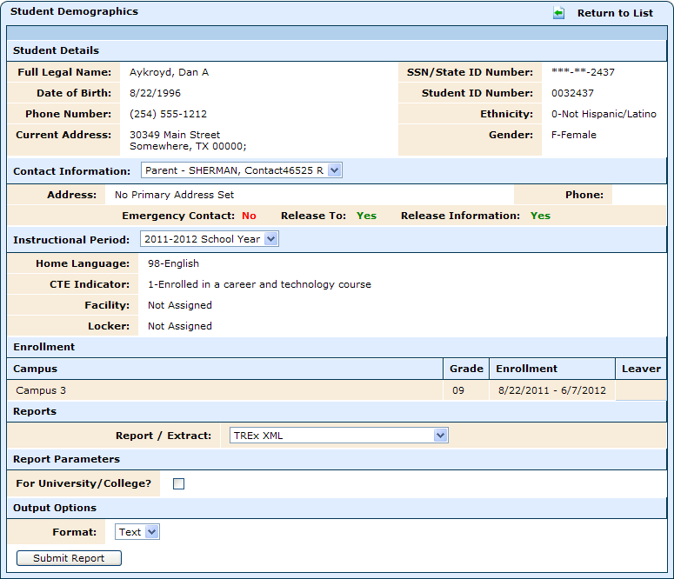
TREx Files
To run a TREx File simply click on the view icon for the student
Select TREx XML from the Report / Extract menu
Submit Report

Slide 24
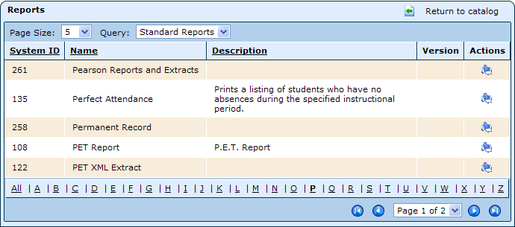
PET Report
To run PET Reports (PET XML Extract), go to Student Reports
Click run report
Set Report Parameters
Submit Report

Slide 25
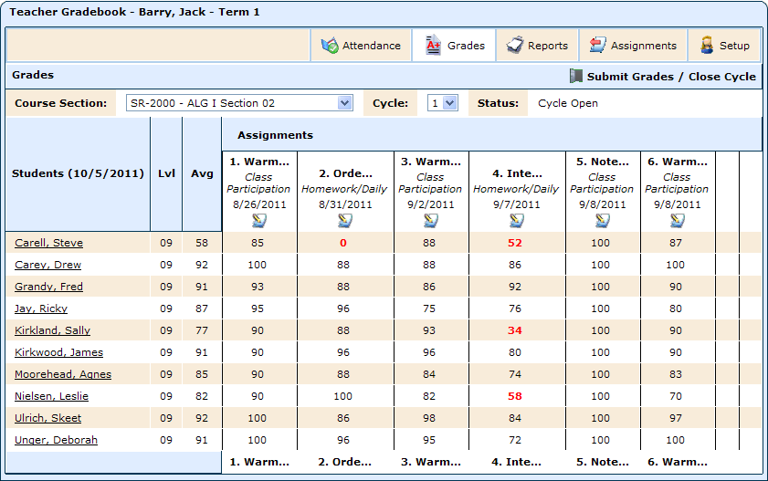
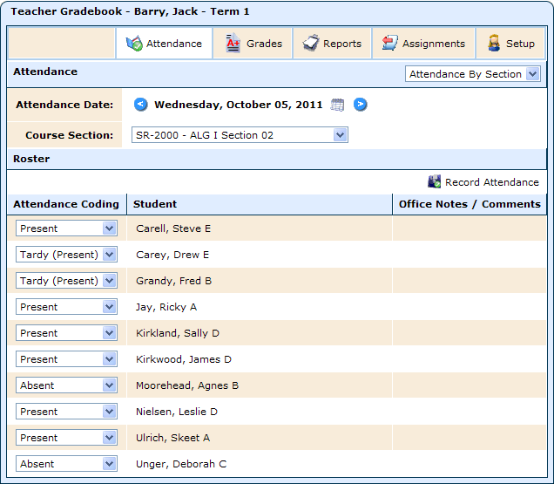
Grades
View a running Average
WebSmart’s integrated Grade Book handles attendance (taken in class), grades, and assignments for Teachers.
Grades entered by Teachers into Grade Book are immediately available to the office.
Attendance can also be handled by the office

Slide 26
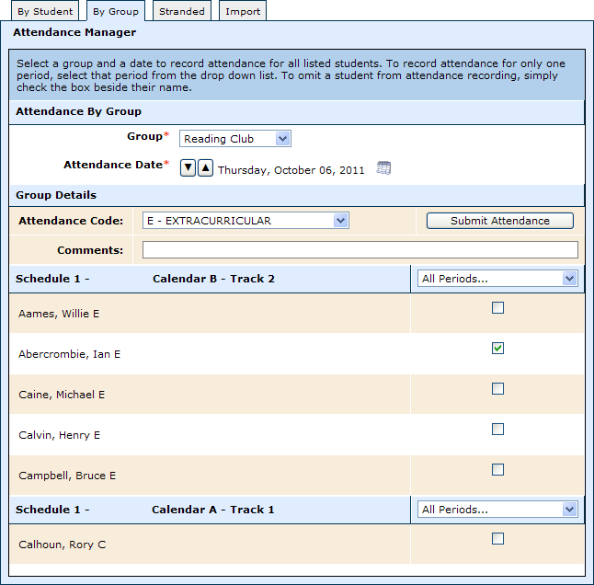
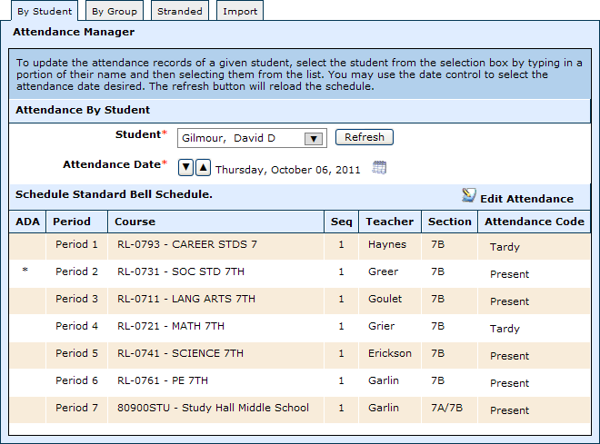
Attendance
Attendance can be taken by period or by ADA (per set up by Admin based on District policy)
Attendance Codes are also customizable by District.
A text field allows the office to make notes that are visible to Teachers in their Grade Books.
Attendance Groups can be created (i.e. Football Team) to allow the same code to be applied to multiple students at once (individuals can be omitted from the group to avoid receiving the same code)

Slide 27
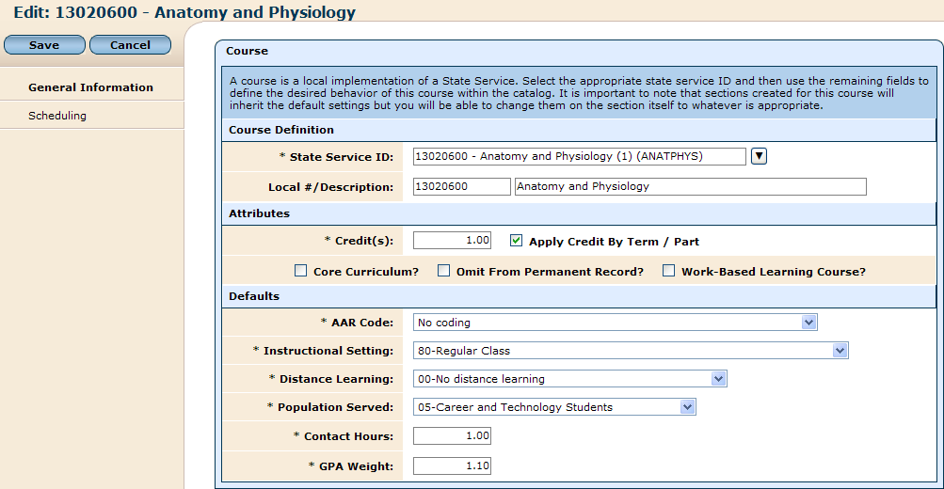
Course Management
WebSmart loads all State Service IDs into the system
Districts customize course area, including courses taught and District naming/numbering scheme

Slide 28
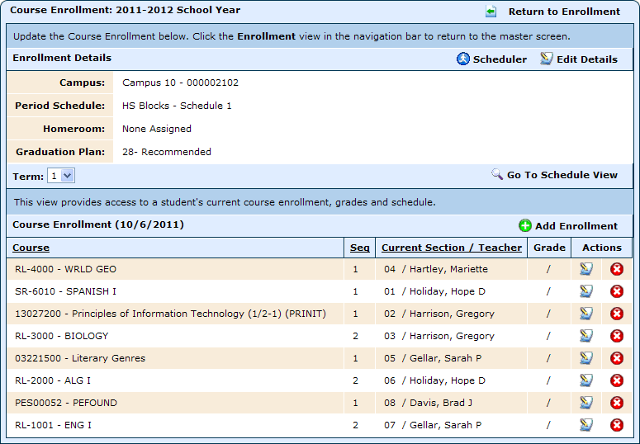
Scheduling Methods
WebSmart handles Scheduling in multiple ways
Mass/Automated Scheduling
Homeroom Scheduling
Walk-in Scheduling
Manual Scheduling by Student and/or Course

Slide 29
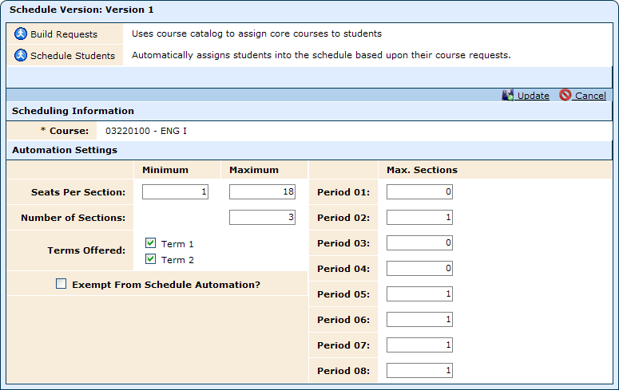
Automated Scheduling
WebSmart handles automated scheduling by processing course requests against a Master Schedule that can be generated by hand entering course sections or by letting the system generate a schedule based on requests. A hybrid of both can be used.

Slide 30
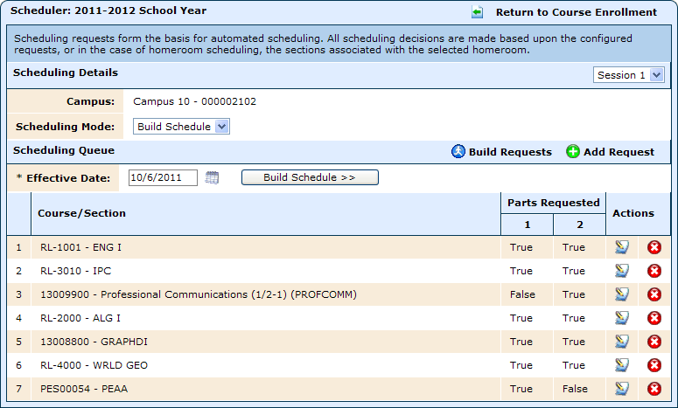
Walk-in Scheduling
WebSmart allows you to handle new students with ease by allowing you to “course request” with the push of a button. You can then adjust courses as needed and click Build Schedule. The system looks for the least populated sections to schedule the student.

Slide 31
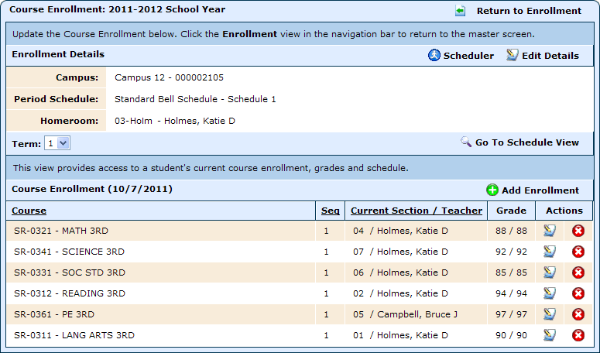
Homeroom Scheduling
Homerooms are created with all the courses associated to it that students will take.
Choose a Homeroom and the students will be scheduled in all associated core and elective courses.

Slide 32
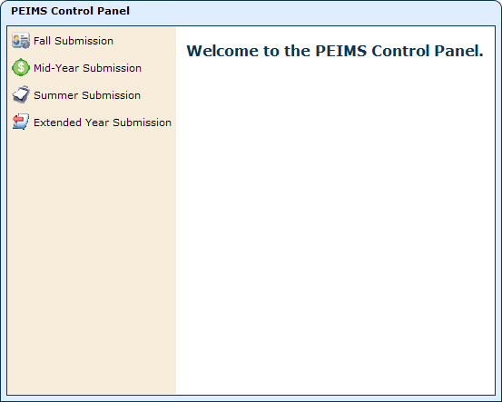
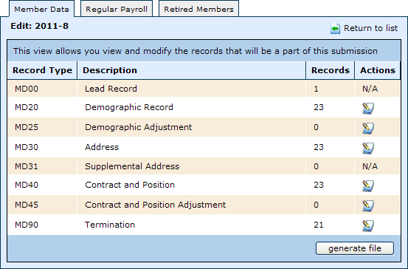
Texas Compliant
PEIMS compliant integrates Texas PEIMS code
Complies with all FASRG standards
TRS TRAQS compliant
Texas audit friendly
Complies with all required state and federal reports including new required web based financial reports
Electronic submissions
Example on next screen

Slide 33
PEIMS Fall Extract
You can see how WebSmart pulls both Finance and Student data without bridging across multiple applications for PEIMS

Slide 34
Feel free to call and speak with one of our
WebSmart Student Services professionals and let them
answer all of your questions
Toll Free (866) 759-1902
Or email us for more information
info@jr3online.com

Slide 35
My Portal
Student's Name
The My Portal tab allows parents/guardians to monitor their student’s Grades and Attendance
It shows current information about the student(s) from the Teachers’ Grade Books
The asterisk beside the grade indicates current course work.
Teachers' Names

Slide 36
Admin
With WebSmart, a District can manage:
Access privileges for individuals and groups
Setup for multiple campuses, bell schedules, calendars
Facilities (i.e. classrooms, lockers)
And so much more…

Slide 37
Security – Users & Groups
Users are created through a template process that defaults a set of access rights to a user in accordance with that template.
Access can be edited on the individual users to further customize their functionality.
Authorization roles and Groups are setup to have limited/specific access based on the District’s preferences.

Slide 38
Districts
WebSmart allows you to manage multiple Districts and Campuses from a single database
The use of Instructional Periods (years) allows you access all prior data with no loading of backups
WebSmart allows a District to give each Campus its own unique setup
The District can define the Grading Template to be District wide or allow the Campuses to define their own Grading Template

Slide 39
Custom Search Reports
Execute customized searches exported to Excel.

Slide 40
Benefits
24/7 Support
Training = no additional cost
Conversion = no additional cost
No need for additional Hardware
No Support Staff required
No updates, no patches to install
All FASRAG / PEIMS / IRS code tables uploaded from Central Server

Slide 41
Thank you for taking the time to learn more about how WebSmart by JR3 can benefit your District. We look forward to hearing from you.
Toll Free (866) 759-1902
info@jr3online.com

